Slide 1


Big Data Seminar – BIA 678
Class 5– Distributed Processing + Data Management
David Belanger PhD
Senior Research Fellow – Stevens Institute of Technology
dbelange@stevens.edu

Slide 2
An Challenging Starting Point
Prof. Michael Stonebraker, MIT
One Size Fits None - (Everything You Learned in Your DBMS Class is Wrong)
http://cs.brown.edu/~ugur/fits_all.pdf

Slide 3
Class 5 Outline
Administrative Stuff:
  Formation of teams Complete
  Term Paper Info
  Next couple of weeks
Activity #1 – This Week’s Readings
  Abadi, et al, “Column-Stores vs. Row-Stores: How Different are they Really,
  Gilbert, CAP Theorem Brewer
Activity #2 – Finish Distributed Programming
Activity #3 –
Assignment #1 – No Readings for Next Week (Reading Assignment for following week).
  Introduction to Cassandra, https://academy.datastax.com/resources/brief-introduction-apache-cassandra
  Introduction to MongoDB, https://docs.mongodb.com/manual/introduction/
Assignment #2
  Counting the occurrence of digits in: e or sqrt(2).

Slide 4
Term paper Discussion

Slide 5
Grading Sheet for Term Papers for BIA678
Individual Traits are graded 1 – 5, 5 being best.
Topic:
Content:
Knowledge Displayed:
Depth (Degree of Difficulty):
Clarity:
Style:
Overall:

Slide 6
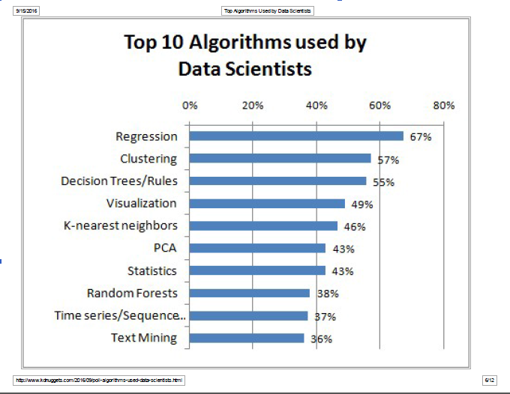

Slide 7
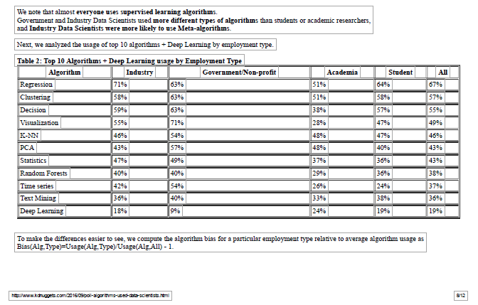

Slide 8
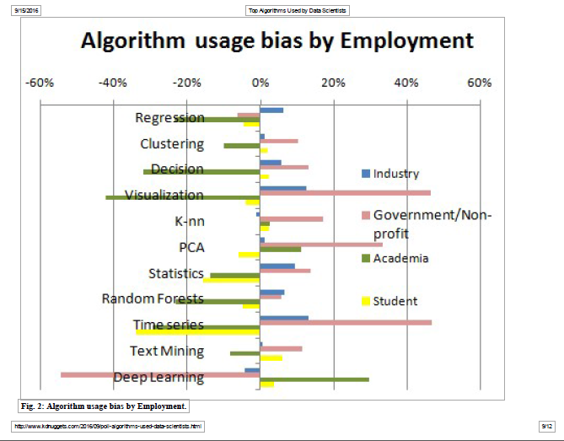

Slide 9
An Alternative Abstraction for Distributed Processing:
Resilient Distributed Datasets
Caveat: Datasets may largely replace RDD in Spark2.0
Issues with Map Reduce:
  Batch Orientation
  Reuse of Output for Iterative Processes
    Examples include many ML algorithms such as:
      K Means
      Logistic Regression
      Random Forest
      Page Rank
    Interactive ML using multiple activities on same dataset.
  That is: in-memory abstractions for distributed processing

Slide 10
A Quick Introduction to Spark

Slide 11
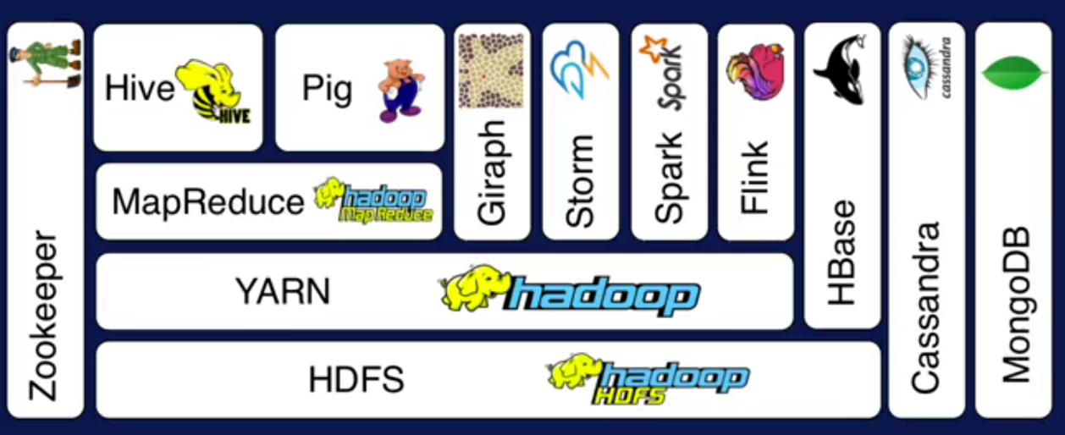
Hadoop Ecosystem
A
Layer Diagram
B
C
D
Source: Apache Hadoop and Spark: Introduction and Use Cases for Data Analytics; Afzal Godil, ITL, NIST

Slide 12
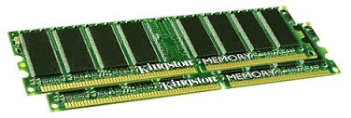
Spark Uses Memory instead of Disk
Hadoop: Use Disk for Data Sharing
HDFS
read
HDFS
Write
HDFS
read
HDFS
Write
Iteration1
Iteration2
Spark: In-Memory Data Sharing
HDFS read
Iteration1
Iteration2
Source: Apache Hadoop and Spark: Introduction and Use Cases for Data Analytics; Afzal Godil, ITL, NIST

Slide 13
Sort competition
 | Hadoop MR Record (2013) | Spark Record (2014)
Data Size | 102.5 TB | 100 TB
Elapsed Time | 72 mins | 23 mins
# Nodes | 2100 | 206
# Cores | 50400 physical | 6592 virtualized
Cluster disk throughput | 3150 GB/s (est.) | 618 GB/s
Network | dedicated data center, 10Gbps | virtualized (EC2) 10Gbps network
Sort rate | 1.42 TB/min | 4.27 TB/min
Sort rate/node | 0.67 GB/min | 20.7 GB/min
Spark, 3x faster with 1/10 the nodes
Sort benchmark, Daytona Gray: sort of 100 TB of data (1 trillion records)
http://databricks.com/blog/2014/11/05/spark-officially-sets-a-new-record-in-large-scale-sorting.html

Slide 14
A Quick Introduction to Spark
Some Data Science Challenges Addressed by Spark:
Natural support of flexible transformations for preprocessing data
Iteration
Exploration + Production

Slide 15
A Quick Introduction to Spark
Some Data Science Challenges Addressed by Spark:
Retains linear scalability and fault tolerance of MapReduce
Extends from MapReduce Format to Directed Acyclic Graph (DAG) Operators
Contains a rich set of embedded transformations
Supports In-Memory Processing
Abstractions: Resilient Distributed Datasets (RDD) => DataSets and DataFrames
Spark-SQL, Spark-ML, PYSpark, …

Slide 16
A Quick Introduction to Spark
Spark Programming Model:
Start with a Data set – often on a distributed, persistent store such as HDFS
Define a set of transformations on the input data set
Output results to:
  Persistent Storage, or
  Driver’s Local Memory
Run local computations on results of distributed computations.
Determine next steps
Apache Spark Examples =>

Slide 17
A Quick Introduction to Spark ML(lib)
ML Functions
Data Types
Statistics
Machine Learning Algorithms
  Regression
    Linear
    Generalized Linear
    Decision Tree
    Random Forest
    Gradient Boosted Tree
    Survival
    Isotonic
  Classification
    Logistic Regression (bi, Multinomial)
    Decision Tree
    Random Forest
    Gradient Boosted Tree
    Linear Support Vector Machine (SVM)
    One-vs-All
    Naïve Bayes
Apache Spark MLLib =>

Slide 18
A Quick Introduction to Spark ML(lib)
ML Functions - 2
Machine Learning Algorithms (Continued)
  Clustering
    K-means
    Latent Dirichlet Allocation
    Bisecting k-means
    Gaussian Mixture Model
  Collaborative Filtering
    Alternating Least Squares (ALS)
Dimension Reduction
  Singular Value Decomposition (SVD)
  Principal Component Analysis (PCA)
Feature Extraction and Transformation
  TF-IDF
  Word2Vec
Optimization
  Stochastic Gradient Descent
  Limited Memory BFGS (L-BFGS)

Slide 19
A Quick Introduction to Spark
DataFrames
New API in Spark Versions 2.x
Replacement for Resilient Distributed Datasets (RDD)
Distributed, strongly typed data
Features:
  Familiarity – RDBMS, R, Python
  Uniform API
  Enables Spark SQL
  Implements a variety of optimizations
  Enables multiple structured sources: CSV, JSON, etc.

Slide 20
A Quick Introduction to Spark
Sources

Slide 21
A Quick Introduction to ML with Spark
Partial Source: https://mapr.com/blog/apache-spark-machine-learning-tutorial/
Machine Learning
Unsupervised Learning
Clustering
Dimension Reduction
Supervised Learning
Classification
Regression
Reinforcement Learning

Slide 22
A Quick Introduction to ML with Spark
Partial Source: https://mapr.com/blog/apache-spark-machine-learning-tutorial/
Machine Learning
Classification
Clustering
Collaborative Filtering
A Detailed Example
Flight Delays

Slide 23
Resilient Distributed Datasets
Some good sources:
  https://www.usenix.org/conference/nsdi12/technical-sessions/presentation/zaharia
  http://www.cs.berkeley.edu/~matei/papers/2012/nsdi_spark.pdf
  http://www.Databricks.com – Many publications

Slide 24
Resilient Distributed Datasets
A Distributed Memory Abstraction that is:
  Fault Tolerant
  Efficient
Solution:
  Restricted form of distributed shared memory:
    Immutable, Partitioned collection of records
    Coarse grained abstractions
  Fault Recovery using Lineage
    Log one operation to apply to many elements
    Recompute lost partitions on failure
    No cost if nothing fails

Slide 25
Resilient Distributed Datasets
RDDs can express multiple programming models (implement in Spark) e.g.:
  MapReduce
  Iterative MapReduce
  SQL
Specifically are useful for:
  Stream Processing (micro batch or near real time)
  Iterative ML Algorithms

Slide 26
An Alternative Abstraction for Distributed Processing
Resilient Distributed Datasets
Interface based of “course grained” transformations, and lazy execution: e.g.
(http://spark.apache.org/docs/1.4.1/programming-guide.html#parallelized-collections )
Transformation | Meaning
map(func) | Return a new distributed dataset formed by passing each element of the source through a function func.
filter(func) | Return a new dataset formed by selecting those elements of the source on which func returns true.
flatMap(func) | Similar to map, but each input item can be mapped to 0 or more output items (so func should return a Seq rather than a single item).

Slide 27
mapPartitions(func) | Similar to map, but runs separately on each partition (block) of the RDD, so func must be of type Iterator<T> => Iterator<U> when running on an RDD of type T.
mapPartitionsWithIndex(func) | Similar to mapPartitions, but also provides func with an integer value representing the index of the partition, so func must be of type (Int, Iterator<T>) => Iterator<U> when running on an RDD of type T.
sample(withReplacement, fraction, seed) | Sample a fraction fraction of the data, with or without replacement, using a given random number generator seed.
union(otherDataset) | Return a new dataset that contains the union of the elements in the source dataset and the argument.
intersection(otherDataset) | Return a new RDD that contains the intersection of elements in the source dataset and the argument.
distinct([numTasks])) | Return a new dataset that contains the distinct elements of the source dataset.

Slide 28
intersection(otherDataset) | Return a new RDD that contains the intersection of elements in the source dataset and the argument.
distinct([numTasks])) | Return a new dataset that contains the distinct elements of the source dataset.

Slide 29
groupByKey([numTasks]) | When called on a dataset of (K, V) pairs, returns a dataset of (K, Iterable<V>) pairs. Note: If you are grouping in order to perform an aggregation (such as a sum or average) over each key, using reduceByKey or aggregateByKey will yield much better performance. Note: By default, the level of parallelism in the output depends on the number of partitions of the parent RDD. You can pass an optional numTasks argument to set a different number of tasks.
reduceByKey(func, [numTasks]) | When called on a dataset of (K, V) pairs, returns a dataset of (K, V) pairs where the values for each key are aggregated using the given reduce function func, which must be of type (V,V) => V. Like in groupByKey, the number of reduce tasks is configurable through an optional second argument.
aggregateByKey(zeroValue)(seqOp, combOp, [numTasks]) | When called on a dataset of (K, V) pairs, returns a dataset of (K, U) pairs where the values for each key are aggregated using the given combine functions and a neutral "zero" value. Allows an aggregated value type that is different than the input value type, while avoiding unnecessary allocations. Like in groupByKey, the number of reduce tasks is configurable through an optional second argument.
sortByKey([ascending], [numTasks]) | When called on a dataset of (K, V) pairs where K implements Ordered, returns a dataset of (K, V) pairs sorted by keys in ascending or descending order, as specified in the boolean ascending argument.
join(otherDataset, [numTasks]) | When called on datasets of type (K, V) and (K, W), returns a dataset of (K, (V, W)) pairs with all pairs of elements for each key. Outer joins are supported through leftOuterJoin, rightOuterJoin, and fullOuterJoin.

Slide 30
cogroup(otherDataset, [numTasks]) | When called on datasets of type (K, V) and (K, W), returns a dataset of (K, (Iterable<V>, Iterable<W>)) tuples. This operation is also called groupWith.
cartesian(otherDataset) | When called on datasets of types T and U, returns a dataset of (T, U) pairs (all pairs of elements).
pipe(command, [envVars]) | Pipe each partition of the RDD through a shell command, e.g. a Perl or bash script. RDD elements are written to the process's stdin and lines output to its stdout are returned as an RDD of strings.
coalesce(numPartitions) | Decrease the number of partitions in the RDD to numPartitions. Useful for running operations more efficiently after filtering down a large dataset.
repartition(numPartitions) | Reshuffle the data in the RDD randomly to create either more or fewer partitions and balance it across them. This always shuffles all data over the network.
repartitionAndSortWithinPartitions(partitioner) | Repartition the RDD according to the given partitioner and, within each resulting partition, sort records by their keys. This is more efficient than calling repartition and then sorting within each partition because it can push the sorting down into the shuffle machinery.

Slide 31
Action | Meaning
reduce(func) | Aggregate the elements of the dataset using a function func (which takes two arguments and returns one). The function should be commutative and associative so that it can be computed correctly in parallel.
collect() | Return all the elements of the dataset as an array at the driver program. This is usually useful after a filter or other operation that returns a sufficiently small subset of the data.
count() | Return the number of elements in the dataset.
first() | Return the first element of the dataset (similar to take(1)).
take(n) | Return an array with the first n elements of the dataset.
takeSample(withReplacement, num, [seed]) | Return an array with a random sample of num elements of the dataset, with or without replacement, optionally pre-specifying a random number generator seed.
takeOrdered(n, [ordering]) | Return the first n elements of the RDD using either their natural order or a custom comparator.
saveAsTextFile(path) | Write the elements of the dataset as a text file (or set of text files) in a given directory in the local filesystem, HDFS or any other Hadoop-supported file system. Spark will call toString on each element to convert it to a line of text in the file.
saveAsSequenceFile(path) (Java and Scala) | Write the elements of the dataset as a Hadoop SequenceFile in a given path in the local filesystem, HDFS or any other Hadoop-supported file system. This is available on RDDs of key-value pairs that implement Hadoop's Writable interface. In Scala, it is also available on types that are implicitly convertible to Writable (Spark includes conversions for basic types like Int, Double, String, etc).
saveAsObjectFile(path) (Java and Scala) | Write the elements of the dataset in a simple format using Java serialization, which can then be loaded using SparkContext.objectFile().
countByKey() | Only available on RDDs of type (K, V). Returns a hashmap of (K, Int) pairs with the count of each key.
foreach(func) | Run a function func on each element of the dataset. This is usually done for side effects such as updating an Accumulator or interacting with external storage systems. Note: modifying variables other than Accumulators outside of the foreach() may result in undefined behavior. See Understanding closures for more details.

Slide 32
Resilient Distributed Dataset
Fundamental Data Structure for Spark
Immutable Collection of Distributed Objects
Can contain Java, Python, or Scala Objects
RDD is Logically Partitioned into datasets that can be computed on different nodes.
A read-only collection of records
Created by:
  Parallelizing an existing dataset
  Using dataset in, e.g. HDFS
  http://homepage.cs.latrobe.edu.au/zhe/ZhenHeSparkRDDAPIExamples.html
Source: spark.apache.org

Slide 33
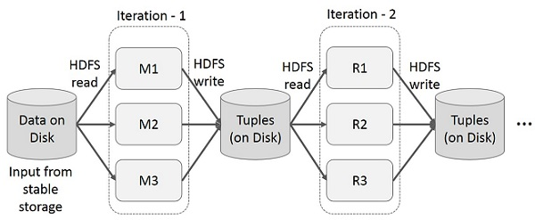
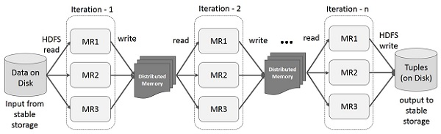
Map Reduce vs RDD Iteration
Estimates are that Hadoop applications spend up to 90% of their time on HDFS I/O.
Source: spark.apache.org
Source: https://www.tutorialspoint.com/apache_spark/apache_spark_rdd.htm

Slide 34
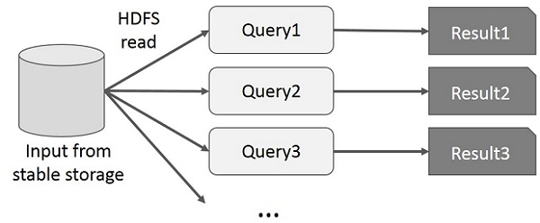
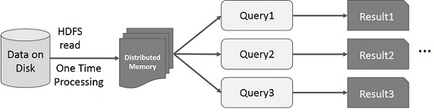
Map Reduce vs RDD Interactive
Source: spark.apache.org

Slide 35
Spark Examples
Word Count - Python
text_file = sc.textFile("hdfs://...")
counts = text_file.flatMap(lambda line: line.split(" ")) \
.map(lambda word: (word, 1)) \
.reduceByKey(lambda a, b: a + b)
counts.saveAsTextFile("hdfs://...")
Source: spark.apache.org

Slide 36
Spark Examples
Word Search - Python
textFile = sc.textFile("hdfs://...")
# Creates a DataFrame having a single column named "line"
df = textFile.map(lambda r: Row(r)).toDF(["line"])
errors = df.filter(col("line").like("%ERROR%"))
# Counts all the errors
errors.count()
# Counts errors mentioning MySQL
errors.filter(col("line").like("%MySQL%")).count()
# Fetches the MySQL errors as an array of strings
errors.filter(col("line").like("%MySQL%")).collect()
Source: spark.apache.org

Slide 37
Matrix Multiplication in Pyspark

Slide 38
Get the result of matrix X multiply matrix Y:
3x3 matrix X = [[10,7,3],[3 ,2,6],[5 ,8,7]]
3x2 matrix Y = [[3,7],[2,7],[8,7]]
Steps
open VM and type pyspark in terminal
Run the following code:
rdd_x = sc.parallelize([[0,0,10],[0,1,7],[0,2,3],[1,0,3],[1,1,2],[1,2,6],[2,0,5],[2,1,8],[2,2,7]])
rdd_y = sc.parallelize([[0,0,3],[0,1,7],[1,0,2],[1,1,7],[2,0,8],[2,1,7]])
rdd_x.cartesian(rdd_y)
.filter(lambda x: x[0][1] == x[1][0])
.map(lambda x: ((x[0][0],x[1][1]),x[0][2] * x[1][2]))
.reduceByKey(lambda x,y: x+y).collect()

Slide 39
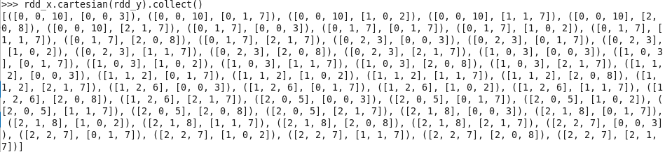
Spark – RDD – Matrix Multiplication
rdd_x = sc.parallelize([[0,0,10],[0,1,7],[0,2,3],[1,0,3],[1,1,2],[1,2,6],[2,0,5],[2,1,8],[2,2,7]])
# for a tuple (x,y,z), the value at row x, column y is z
rdd_y = sc.parallelize([[0,0,3],[0,1,7],[1,0,2],[1,1,7],[2,0,8],[2,1,7]])
# for a tuple (x,y,z), the value at row x, column y is z
rdd_x.cartesian(rdd_y)
# get all possible pairs

Slide 41
Spark – RDD – Matrix Multiplication
rdd_x.cartesian(rdd_y)
# get all possible pairs
.filter(lambda x: x[0][1] == x[1][0])
# get only those numbers that will get multiplied

Slide 42
Spark – RDD – Matrix Multiplication
rdd_x = sc.parallelize([[0,0,10],[0,1,7],[0,2,3],[1,0,3],[1,1,2],[1,2,6],[2,0,5],[2,1,8],[2,2,7]])
# for a tuple (x,y,z), the value at row x, column y is z
rdd_y = sc.parallelize([[0,0,3],[0,1,7],[1,0,2],[1,1,7],[2,0,8],[2,1,7]])
# for a tuple (x,y,z), the value at row x, column y is z
rdd_x.cartesian(rdd_y)
# get all possible pairs
.filter(lambda x: x[0][1] == x[1][0])
# get only those numbers that will get multiplied

Slide 43
Spark – RDD – Matrix Multiplication
.filter(lambda x: x[0][1] == x[1][0])
# get only those numbers that will get multiplied
.map(lambda x: ((x[0][0],x[1][1]),x[0][2] * x[1][2]))
# mapper: make index for result, (row, col)

Slide 44
Spark – RDD – Matrix Multiplication
rdd_x = sc.parallelize([[0,0,10],[0,1,7],[0,2,3],[1,0,3],[1,1,2],[1,2,6],[2,0,5],[2,1,8],[2,2,7]])
# for a tuple (x,y,z), the value at row x, column y is z
rdd_y = sc.parallelize([[0,0,3],[0,1,7],[1,0,2],[1,1,7],[2,0,8],[2,1,7]])
# for a tuple (x,y,z), the value at row x, column y is z
rdd_x.cartesian(rdd_y)
# get all possible pairs
.filter(lambda x: x[0][1] == x[1][0])
# get only those numbers that will get multiplied
.map(lambda x: ((x[0][0],x[1][1]),x[0][2] * x[1][2]))
# mapper: make index for result, (row, col)

Slide 45
Spark – RDD – Matrix Multiplication
.map(lambda x: ((x[0][0],x[1][1]),x[0][2] * x[1][2]))
# mapper: make index for result, (row, col)
.reduceByKey(lambda x,y: x+y).collect()
# reducerBykey: add to get the result

Slide 46
Spark – RDD – Matrix Multiplication
rdd_x = sc.parallelize([[0,0,10],[0,1,7],[0,2,3],[1,0,3],[1,1,2],[1,2,6],[2,0,5],[2,1,8],[2,2,7]])
# for a tuple (x,y,z), the value at row x, column y is z
rdd_y = sc.parallelize([[0,0,3],[0,1,7],[1,0,2],[1,1,7],[2,0,8],[2,1,7]])
# for a tuple (x,y,z), the value at row x, column y is z
rdd_x.cartesian(rdd_y)
# get all possible pairs
.filter(lambda x: x[0][1] == x[1][0])
# get only those numbers that will get multiplied
.map(lambda x: ((x[0][0],x[1][1]),x[0][2] * x[1][2]))
# mapper: make index for result, (row, col)
.reduceByKey(lambda x,y: x+y).collect()
# reducerBykey: add to get the result

Slide 47
Spark Examples
MySQL - Python
# Creates a DataFrame based on a table named "people"
# stored in a MySQL database.
url = \
"jdbc:mysql://yourIP:yourPort/test?user=yourUsername;password=yourPassword"
df = sqlContext \
.read \
.format("jdbc") \
.option("url", url) \
.option("dbtable", "people") \
.load()
# Looks the schema of this DataFrame.
df.printSchema()
# Counts people by age
countsByAge = df.groupBy("age").count()
countsByAge.show()
# Saves countsByAge to S3 in the JSON format.
countsByAge.write.format("json").save("s3a://...")
Source: spark.apache.org

Slide 48
Spark Examples
Logistic Regression - Python
# Every record of this DataFrame contains the label and
# features represented by a vector.
df = sqlContext.createDataFrame(data, ["label", "features"])
# Set parameters for the algorithm.
# Here, we limit the number of iterations to 10.
lr = LogisticRegression(maxIter=10)
# Fit the model to the data.
model = lr.fit(df)
# Given a dataset, predict each point's label, and show the results.
model.transform(df).show()
Source: spark.apache.org

Slide 49
Spark Examples
Logistic Regression - Scala
// Every record of this DataFrame contains the label and
// features represented by a vector.
val df = sqlContext.createDataFrame(data).toDF("label", "features")
// Set parameters for the algorithm.
// Here, we limit the number of iterations to 10.
val lr = new LogisticRegression().setMaxIter(10)
// Fit the model to the data.
val model = lr.fit(df)
// Inspect the model: get the feature weights.
val weights = model.weights
// Given a dataset, predict each point's label, and show the results.
model.transform(df).show()
Source: spark.apache.org

Slide 50
Spark Examples
Logistic Regression - Java
// Every record of this DataFrame contains the label and
// features represented by a vector.
StructType schema = new StructType(new StructField[]{
new StructField("label", DataTypes.DoubleType, false, Metadata.empty()),
new StructField("features", new VectorUDT(), false, Metadata.empty()),
});
DataFrame df = jsql.createDataFrame(data, schema);
// Set parameters for the algorithm.
// Here, we limit the number of iterations to 10.
LogisticRegression lr = new LogisticRegression().setMaxIter(10);
// Fit the model to the data.
LogisticRegressionModel model = lr.fit(df);
// Inspect the model: get the feature weights.
Vector weights = model.weights();
// Given a dataset, predict each point's label, and show the results.
model.transform(df).show();
Source: spark.apache.org

Slide 51
BIG Big Data Public-Private Forum

